Slide 1
Capstone Design Proposal Presentation

Slide 2
Hello!
We are “LAJI”
-Jisu An
-Hyunjae Lee
-Jinwoo Jeon

Slide 3
Meet the Team
1
AN JISU
LEE HYUNJAE
JEON JINWOO
Jane Doe
Jane Doe
Jane Doe
BACKEND DEVELOPER
backend developer
FRONTEND DEVELOPER
Server management, Server-side development
Database, Server-side development
Highlight algorithm, Dashboard UI
ajs7270@gmail.com
leehj8687@email.com
zinuzian@gmail.com
Notes:
© Copyright Showeet.com – Creative & Free PowerPoint Templates

Slide 4
Contents
Project overview
Feedback reviews
5th week’s progress
Additional works
Schedule
Q&A

Slide 5
Project overview

Slide 6
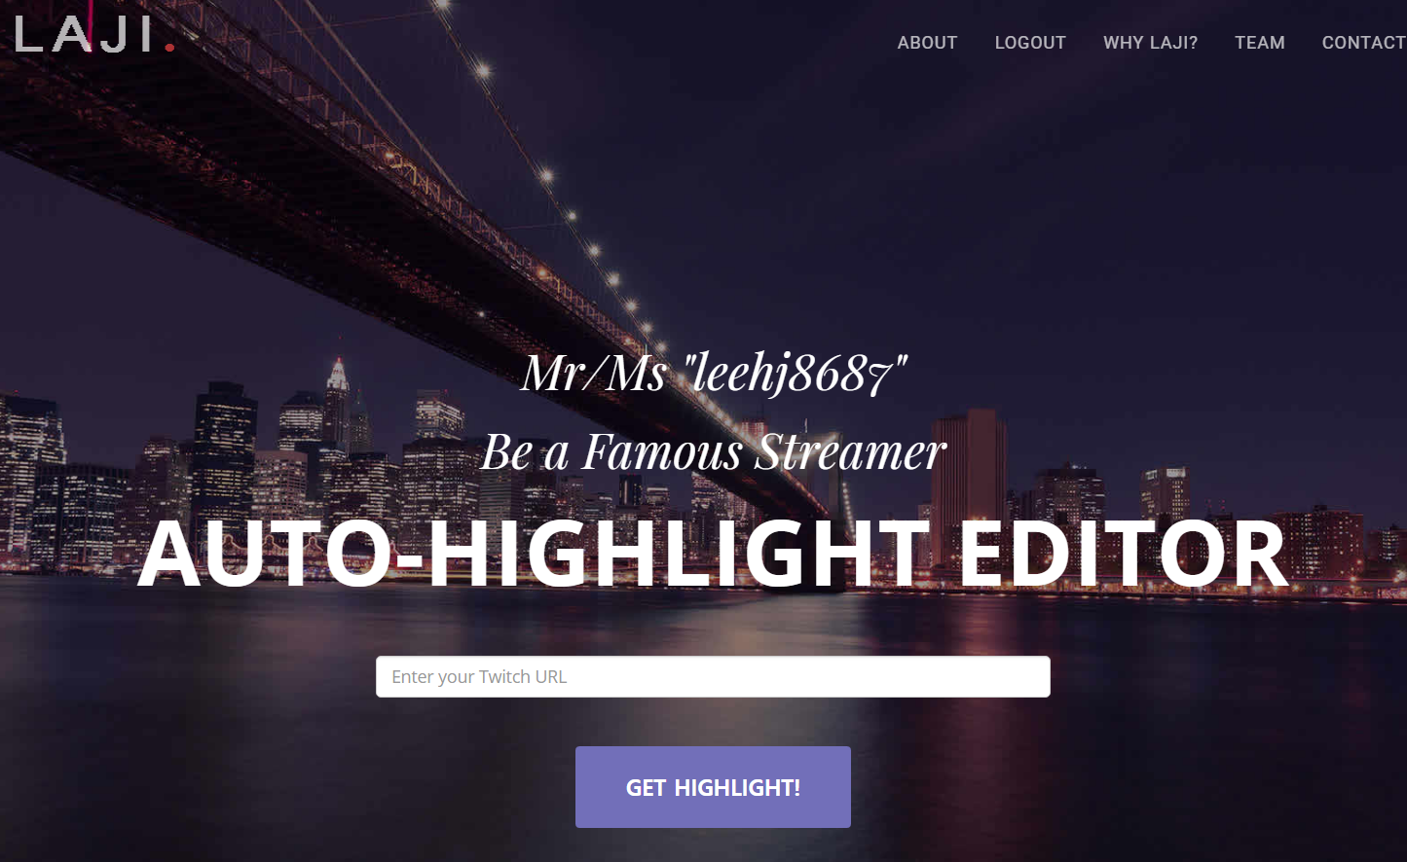
Project overview

Slide 7
Feedback reviews

Slide 8
Feedback reviews
What do we have to answer?
You said, Frame resizing will be tough. Why don’t you begin earlier?
Are you sure legally that you can get video files from Twitch server?

Slide 9
Feedback reviews
<5th week individual plan>
Jisu : Video upload & download
Hyunjae : Twitch Api analyze
Jinwoo : Twitch Api analyze

Slide 10
Feedback reviews
<5th week individual plan>
Jisu : Video upload & download
Hyunjae : Twitch Api analyze
Jinwoo : Twitch Api analyze
All Together : Frame resizing idea discussion

Slide 11
Feedback reviews
What do we have to answer?
You said, Frame resizing will be tough. Why don’t you begin earlier?
Are you sure legally that you can get video files from Twitch server?

Slide 12
Feedback reviews
Email to Twitch ➔ Not informative
Search and Ask around ➔ Some info we could get

Slide 13
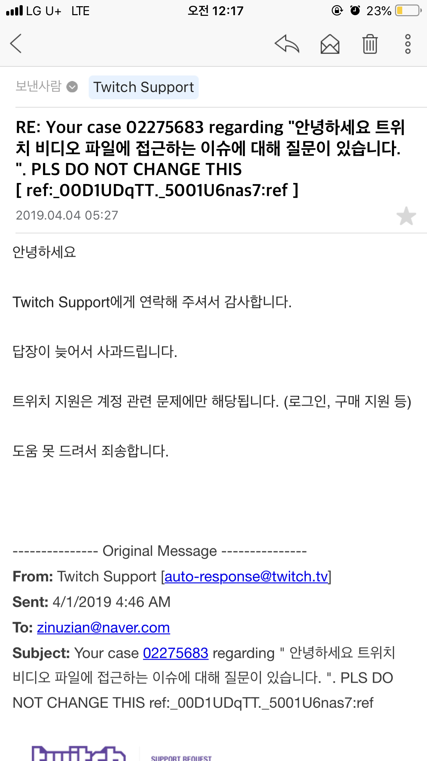

Slide 14
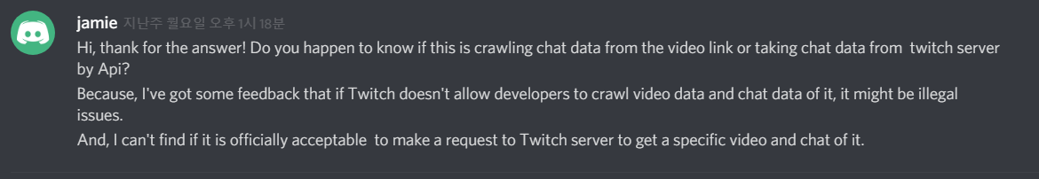
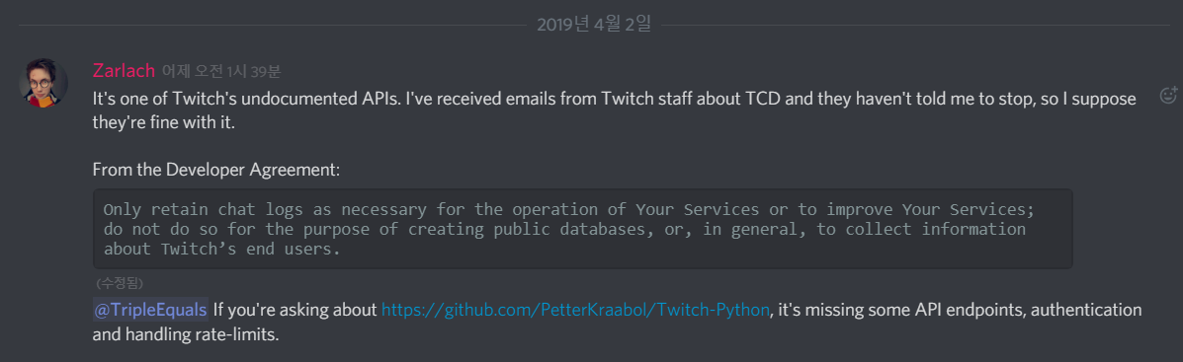
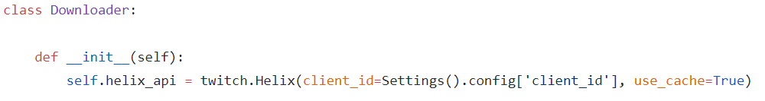

Slide 15
Feedback conclusion
How will we get video files? ➔ Client Uploading
How will we get chat log? ➔ with Twitch Api and url (user input)

Slide 16
5th week’s progress

Slide 17
5th week’s progress
Video upload & download - Jisu
TCA - DB construction - Hyunjae
TCA – Subprocessing - Jinwoo

Slide 18
5th week’s progress
Video upload & download

Slide 19
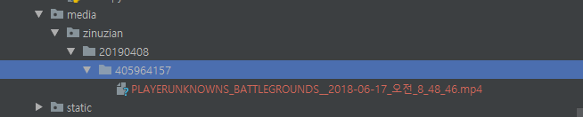
Video upload & download
Result

Slide 20
Video upload & download
Issue <File upload Path>
: /media/
since our path will be decided in runtime, so we change settings.MEDIA.ROOT
Notes:
Django는 미디어파일의 경우 /media/에 업로드되도록 설정하는게 보통이다. 모델 안에 있는 FileField를 통해 업로드를 하는데 upload_to 라는 속성이 있어 여기에 경로를 주면 된다. 근데 우리는 이 경로가 런타임에 동적으로 결정되기 때문에 수정이 되지 않는 문제가 있었다. 이를 settings.MEDIA_ROOT 라는 변수 자체를 수정해버림으로써 해결했다

Slide 21
Video upload & download
Issue <Large file uploading>
: we will use Nginx in web server

Slide 22
5th week’s progress
TCA - DB construction

Slide 23
TCA – DB construction
USER(1)
VIDEO(1)
VIDEO(1)
VIDEO(2)
Video option
10s:delay
T:face recognition
T:voice recognition
T: chat log analyze
Video option
20s:delay
F:face recognition
F:voice recognition
T: chat log analyze
Video option
10s:delay
T:face recognition
T:voice recognition
T: chat log analyze
URL
:video file
:chat log
:highlight video file
URL
:video file
:chat log
:highlight video file
URL
:video file
:chat log
:highlight video file

Slide 24
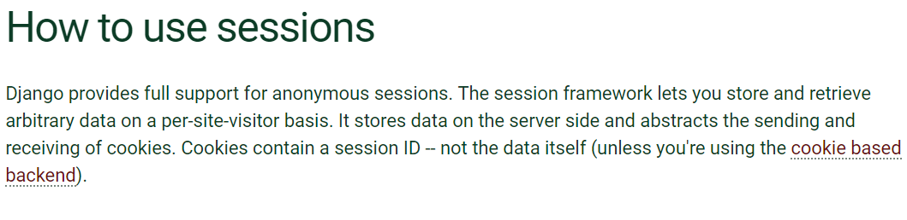
TCA – DB construction

Slide 25
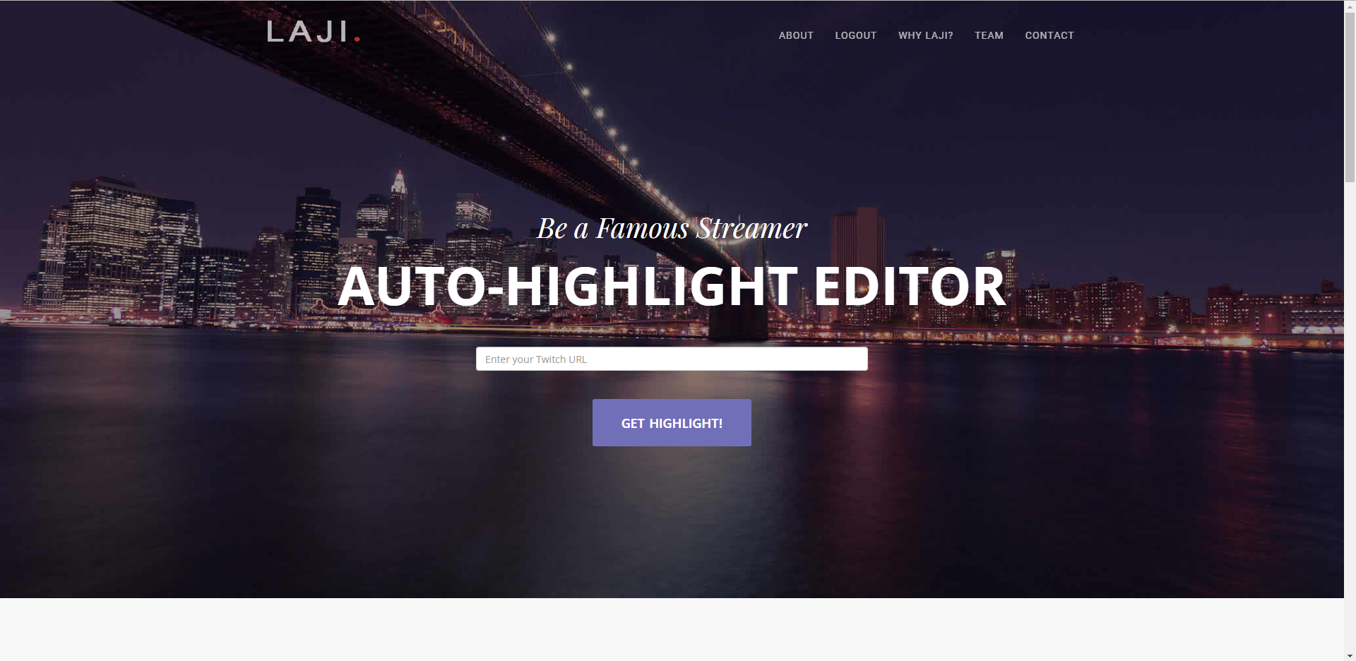
TCA – DB construction
DATABASE
User Info

Slide 26
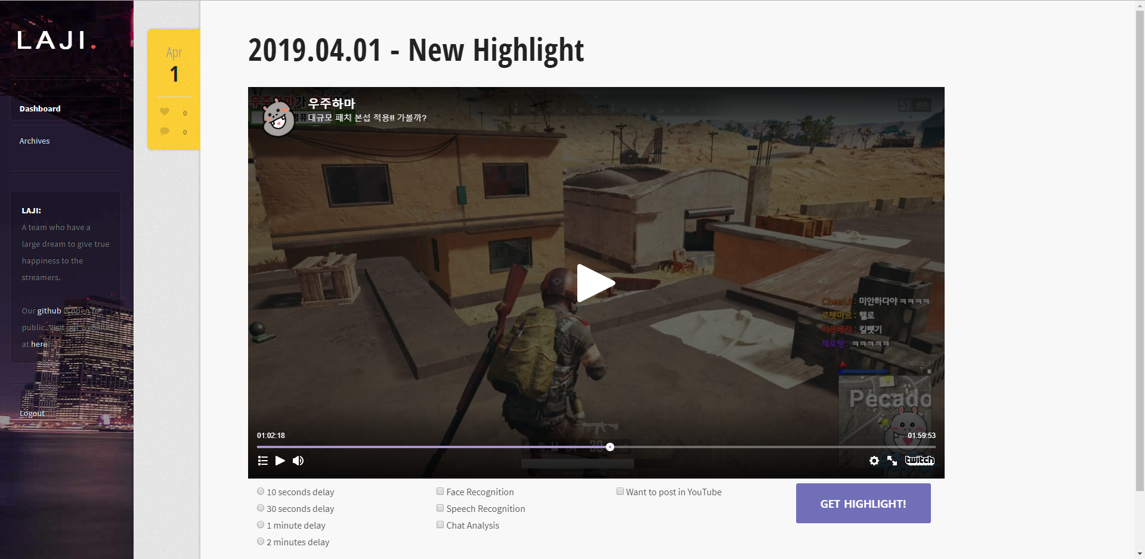
TCA – DB construction
URL info
Session
User Info

Slide 27
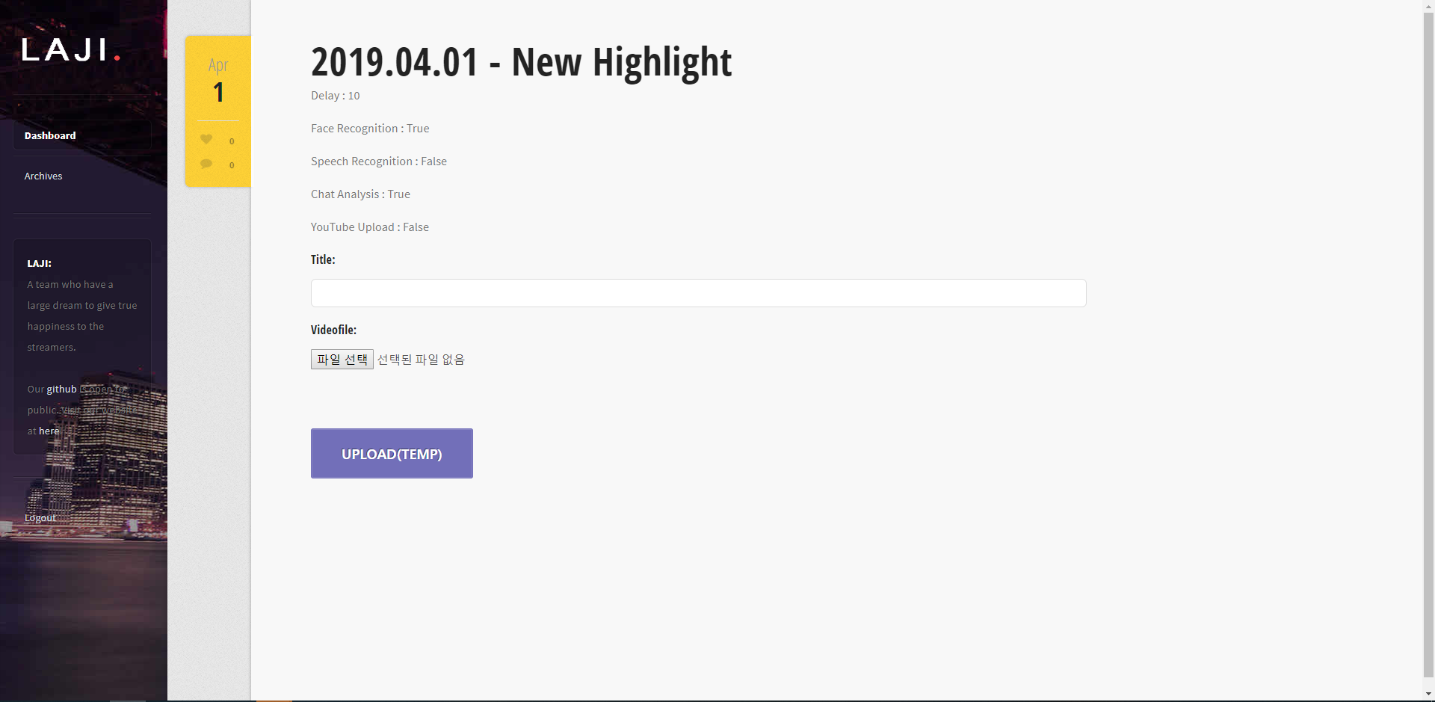
TCA – DB construction
URL info
Session
User Info
Delay : 10s
Face recog : True
Voice reocg: True
Chat log: True
Resized_Frame : (Researching)

Slide 28
TCA – DB construction

Slide 29
TCA – DB construction
URL info
Session
User Info
Delay : 10s
Date : date
Face recog : True
Voice reocg: True
Chat log: True
Resized_Frame : (Researching)
File_URL: char

Slide 30
TCA – DB construction
URL info
Video Info
Delay : 10s
Date : date
Face recog : True
Voice reocg: True
Chat log: True
Resized_Frame : (Researching)
File_URL: char
User Info

Slide 31
TCA – DB construction
DB:
→USER → hyunjae/date/videoID
:chat.log
:yourvideo.mp4
After rendering?

Slide 32
TCA – DB construction
DB:
→USER → hyunjae/date/videoID
:chat.log
:yourvideo.mp4
→hyunjae/date/renderedID
:renderedVideo.mp4
:(some analyze info)

Slide 33
5th week’s progress
TCA – Subprocessing

Slide 34
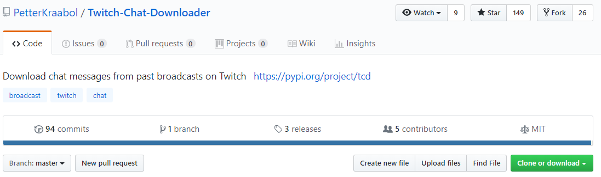
TCA - Subprocessing
Notes:
ㅅ

Slide 35
TCA - Subprocessing
Django
1
Twitch chat downloader
3
2
4
Chat
log
DB
Notes:
ㅅ

Slide 36
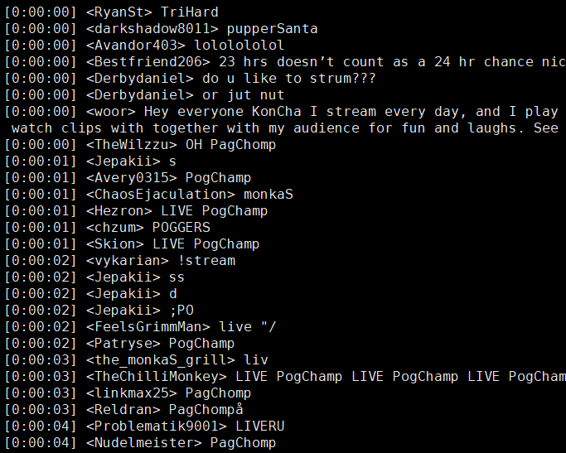
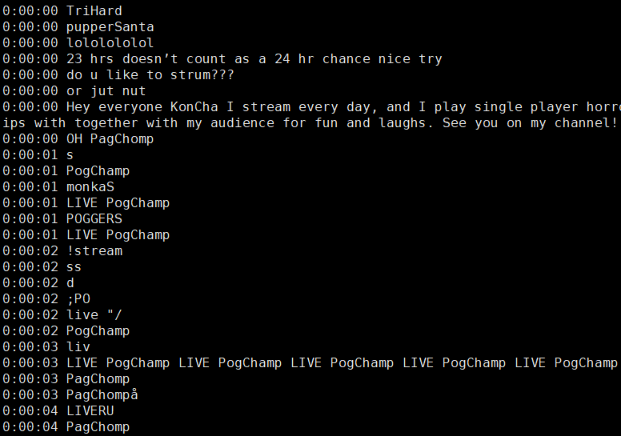
TCA - Subprocessing

Slide 37
Additional works

Slide 38
Additional works
Process Flow Design
Thumbnail
Frame resizing idea discussion

Slide 39
Additional works : Process Flow Design

Slide 40
Additional works : Process Flow Design
URL
View
Template
/
goHome()
redirect
/home/
index()
/home/index.html
/social/
social_login()
/user_management/social_login.html
/oauth/
social_django.urls
redirect
/home/
index()
/home/index.html

Slide 41
Additional works : Process Flow Design
URL
View
Template
/mypage/dashboard/
dashboard()
/mypage/dashboard.html
/mypage/dashboard/opts
uploadOptions()
redirect
/mypage/dashboard/upload
upload()
/mypage/upload.html
redirect
/mypage/history/
history()
/mypage/history.html

Slide 42
Additional works : Process Flow Design
URL
View
Template
/logout/
logout()
redirect
/home/
index()
/home/index.html

Slide 43
Additional works : Thumbnail

Slide 44
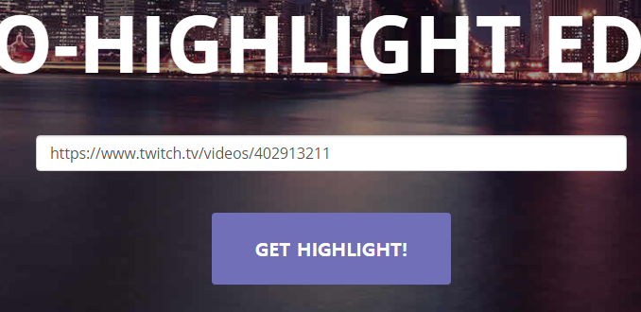
Additional works : Thumbnail

Slide 45
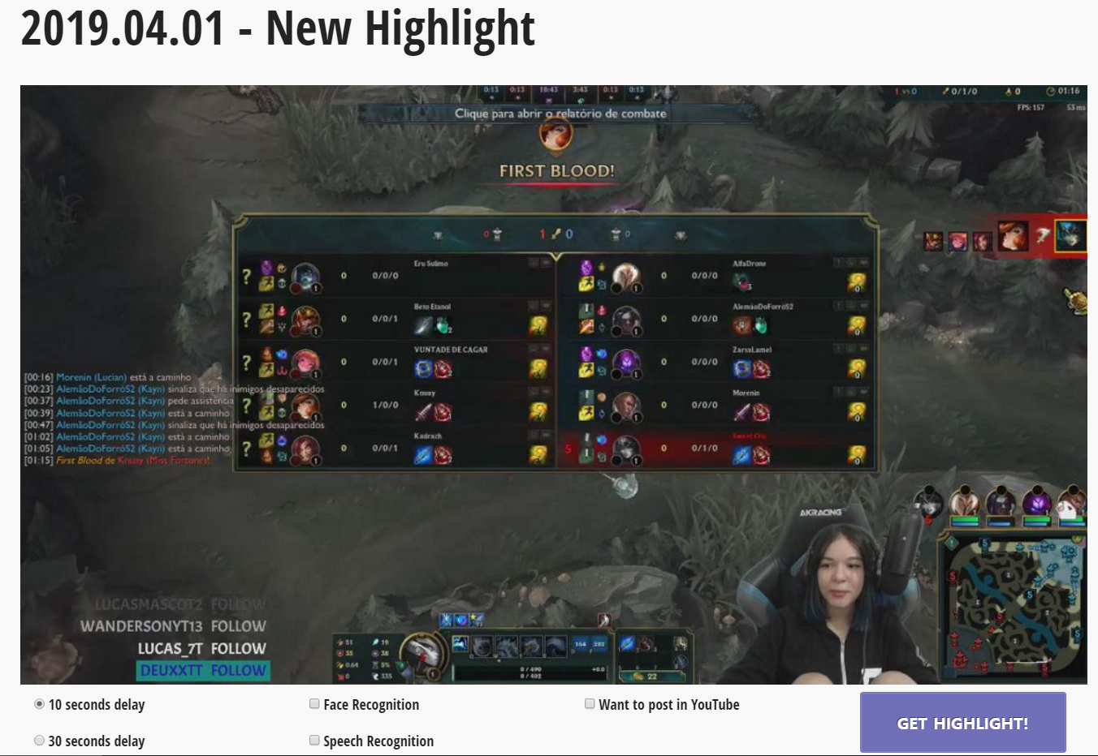
Additional works : Thumbnail

Slide 46
Additional works : Frame resizing idea discussion

Slide 47
Additional works : Frame resizing idea discussion

Slide 48
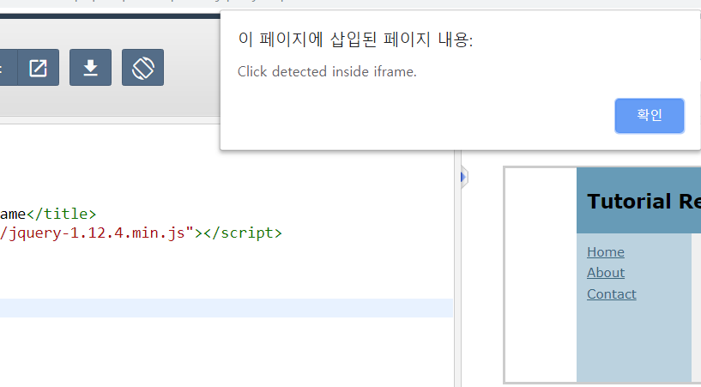
Additional works : Frame resizing idea discussion
1.

Slide 49
Additional works : Frame resizing idea discussion

Slide 50
Development plans

Slide 51
Development plans
Week | Plan
1st | Idea & Proposal
2nd | Idea & Proposal
3rd | Server construction (Configuration setup : Nginx, domain(bind9), https), Test videos (Twitch/Game/Eng)
4th | Login (SNS), Database construction, Dashboard UI
5th | Video upload & download, Twitch chat API analyze, Frame resizing
6th | Frame resizing, Designing highlight algorithm
7th | Demo

Slide 52
Development plans
8th | Highlight video analyze algorithm development, Linking database to system
9th | Highlight video analyze algorithm development, Linking database to system
10th | Highlight video analyze algorithm development and link to system, Linking database to system
11st | Toss (payment), Test
12nd | Notification mail, History, Server test
13rd | Preparing for Final demo
14th | Final demo
15th | Final report
Notes:
뒤도 손좀 봤음(조교님 피드백)
하이라이트 알고리즘과 DB연동이 주 내용이고 토스랑 알림메일 하면 끝

Slide 53
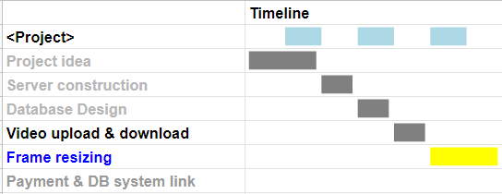
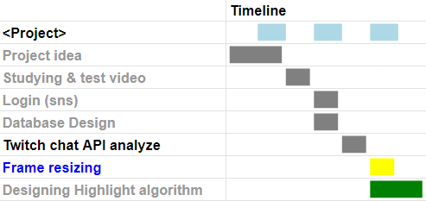
Jisu, An
Hyunjae, Lee
Notes:
손좀 보다보니 개인 스케줄도 어느정도 수정됨
지수는 서버설계, 영상 다운로드, 방송자 얼굴 위치만 따는 거 하고 토스랑 알림메일 할거

Slide 54
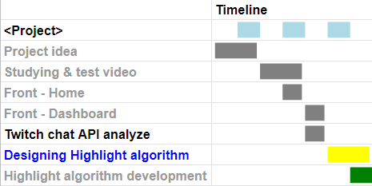
Jinwoo Jeon,
Notes:
현재는 로그인과 디비설계 햇고 채팅 api 활용해서 채팅 얻어오는 것 할거임
마찬가지로 방송자 얼굴 따는거랑 하이라이트 알고리즘 만들거

Slide 55
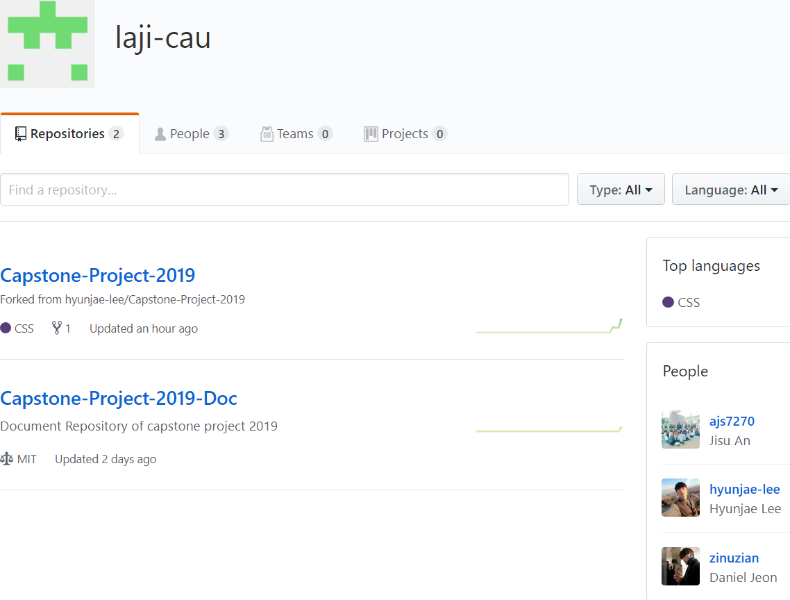
Thank you!

Slide 56
Thank you!

